Slide 1
Regular Expressions
Ivan Santiago De Jesus
CECS 3210-21 – Advanced Programming

Slide 2
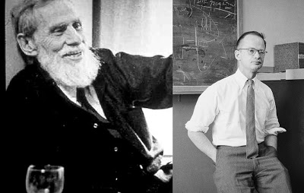
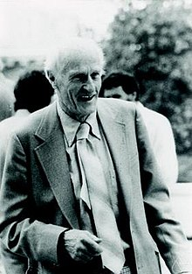
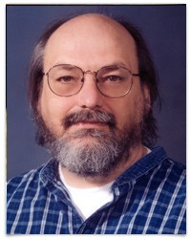
Introduction: Brief History
The idea of regular expressions first surged from the field of neuroscience when in 1943 McCulloch and Pitts developed models describing how the nervous system works.^{[1]}
Stephen Kleene in 1956 took this idea and described regular languages using his mathematical notations called regular events.^{[2]}
In 1968, Ken Thompson a mathematician and one of the key developers of UNIX implemented regular expression inside the text editor called ed. That is the entry point of regX into computing world.^{[1]}
From left to right: Warren S. McCulloch, Walter H. Pitts, Stephen C. Kleene and Ken Thompson

Slide 3
What are regular expressions?
Regular expressions (called REs, or regexes, or regex patterns) are essentially a tiny, highly specialized programming language embedded inside Python and made available through the re module.^{[3]}
For the purpose of this presentation, we will use the terms pattern(s) or regex(es).

Slide 4
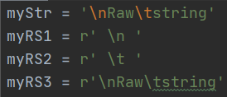
What are raw strings?
By preceding an ‘r’ or ‘R’ in a str or byte literal, you can obtain its raw string.
What this means is the characters in the literal will be interpreted equally as any normal character.
For example, one normally cannot print the newline (‘\n’) escape sequence since it will just add a line break to the string. When adding an ‘r’ or ‘R’ in front of the string, we can print both ‘\’ and ‘n’ characters normally. The same goes for the rest of the escape sequences.

Slide 5

The re module
The most used functions from the re module are the match() and search() methods.
match() has a boolean value of True if there is an exact match for the regex.
search() is True if the regex is found at least once in the given string.
These functions also return a match object, which can further aid the pattern recognition with functions such as group(), start(), end() and span().

Slide 6

The re module
The sub() function allows to replace a certain string in the given pattern.
If the count argument is not given, then the substitution will occur in all of the string.

Slide 7
Metacharacters
Metacharacters are a special set of characters that provide specific instructions to a regular expression. Basically, when inserting these metacharacters in the regex, we condition it to accept a defined set of characters.
However, if you want to match a character that is part of the metacharacter set, then you have to use the backslash (‘\’) to escape them.
^{[3]}
List of metacharacters in Python

Slide 8
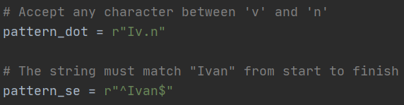
Metacharacters
The first metacharacter we will discuss, is the dot (‘.’). This matches any character, other than a new line.^{[5]}
The next two metacharacters are ^ (caret) and $ (USD symbol). These match the start and end of a string, respectively.^{[5]}

Slide 9
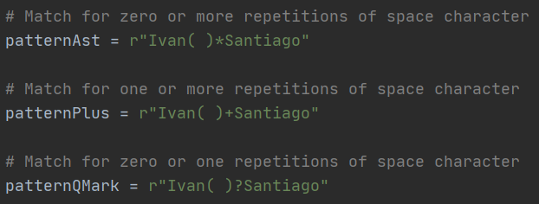
Metacharacters
The * (asterisk), + (plus sign) and ? (question mark) metacharacters are used to identify repetitions in the regex.
The first one matches if “zero or more repetitions of the preceding” are found.
The second, means “one or more repetitions”.
Lastly, the third one, means “zero or one repetitions”.
All of them apply the operation to the characters before the metacharacter.

Slide 10
Metacharacters
Now, let us look at the more sophisticated metacharacters which are the curly braces, parenthesis and square brackets.
Curly braces { } can be used to represent the number of repetitions between two numbers. The regex {x,y} means "between x and y repetitions of something".^{[5]}
Parenthesis ( ) create groups inside regexes. These groups can be used to designate arguments to other metacharacters more precisely.
Character classes are made with the square brackets [ ] and indicate that the match will be successful with only a specific set of characters. You can also build a range of characters for the class using the dash (“-”) character.
Note that in all of these cases, the symbols indicate the match must occur in the designated place of the pattern if other characters or groups are present.

Slide 11
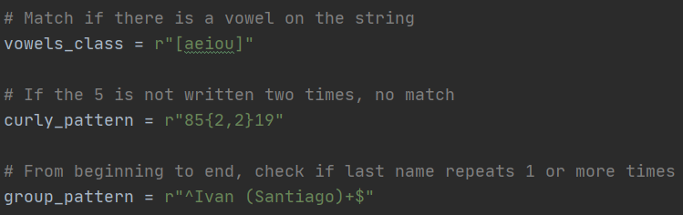
Metacharacters

Slide 12
Special Sequences
Special sequences are similar to escape sequences in strings in terms that they use the backslash character (‘\’) followed by a single character to indicate a specific function.
Some special sequences include \d, \s, and \w. They match digits, whitespace, and word characters respectively.
In ASCII mode they are equivalent to [0-9], [ \t\n\r\f\v], and
[a-zA-Z0-9_].^{[5]}
They are are also available with the letters capitalized to indicate their complements. For example, if you write \D, then it will match anything that is not a digit.

Slide 13
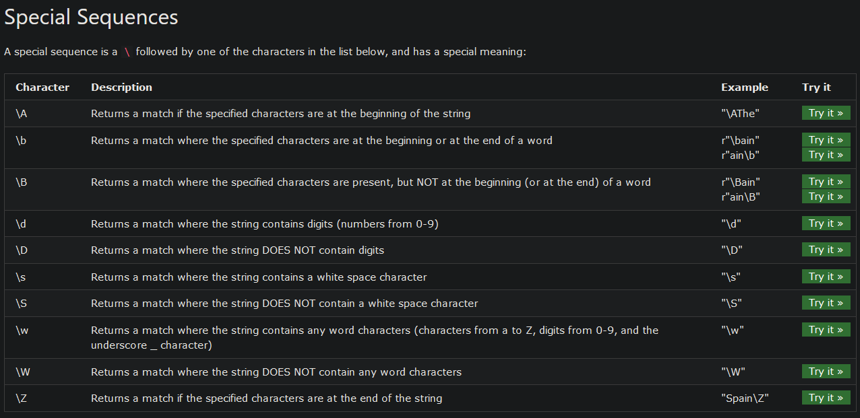
Special Sequences
^{[6]}

Slide 14
Conclusion
“This is cool and all, but do strings not provide equivalent functions for recognition?” That is correct. The are many forums on the discussion of this topic and what I will give is my conclusion.
Always try to use string methods when possible. They are faster, easier to read and maintain.
If you need precision and think that the task can be done simpler with regular expressions, then use them.
I believe that the mastery of both tools can help you build the most optimal pattern recognition algorithms for your problem.

Slide 15
References
[1] Murugan, M. (2019, August 16). Regular Expression: Part 1. Retrieved from https://medium.com/@minisha.mit/regular-expression-part-1-8d75128f627
[2]Leung, Hing (16 September 2010). "Regular Languages and Finite Automata" https://web.archive.org/web/20131205193130/https://www.cs.nmsu.edu/historical-projects/Projects/kleene.9.16.10.pdf
[3]Regular Expression HOWTO¶. (n.d.). Retrieved from https://docs.python.org/3/howto/regex.html
[4]re - Regular expression operations¶. (n.d.). Retrieved from https://docs.python.org/3/library/re.html#match-objects
[5]Python Course. (n.d.). Retrieved from https://www.sololearn.com/Play/Python/
[6](n.d.). Retrieved from https://www.w3schools.com/python/gloss_python_regex_sequences.asp

Slide 16
Link for examples in Python
The following link provides the examples used along this presentation:
https://github.com/ivansdj68/regex-presentation.git

